Slide 1

INTRODUCTION TO DATA SCIENCE
JC + EG
Lecture #18 – 4/5/2022
Lecture #20 – 11/4/2021
CMSC320

Slide 2

ANNOUNCEMENTS
Project 2 grades are not finalized/out yet!
Project 3 is out

Slide 3
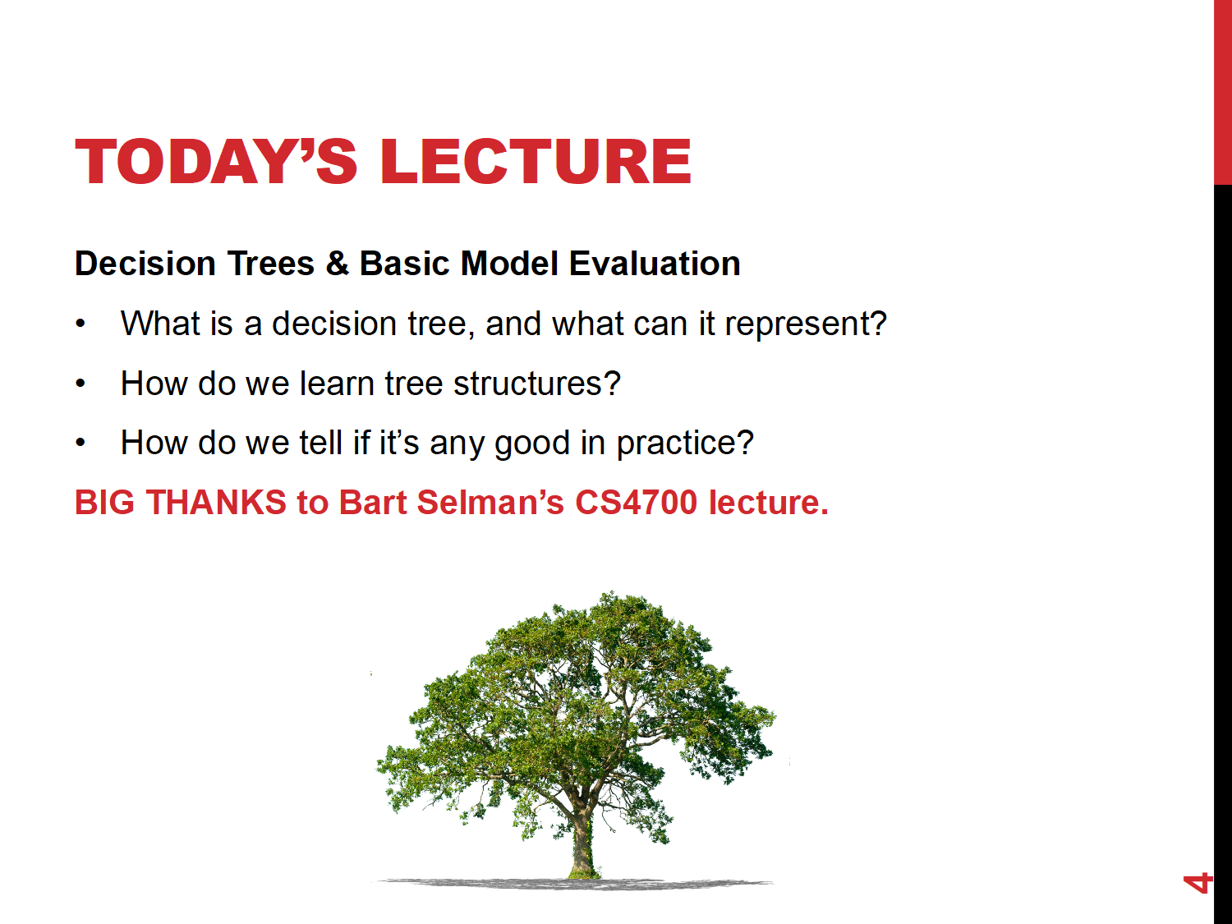

Slide 4
Evaluation Methodology
General for Machine Learning

Slide 5
Evaluation Methodology
How to evaluate the quality of a learning algorithm, i.e.,:
How good are the hypotheses produced by the learning algorithm?
How good are they at classifying unseen examples?
Standard methodology (“Holdout Cross-Validation”):
1. Collect a large set of examples.
2. Randomly divide collection into two disjoint sets: training set and test set.
3. Apply learning algorithm to training set generating hypothesis h
4. Measure performance of h w.r.t. test set (a form of cross-validation)
🡪 measures generalization to unseen data
Important: keep the training and test sets disjoint! “No peeking”!
Note: The first two questions about any learning result: Can you describe
your training and your test set? What’s your error on the test set?
Notes:
Peeking – example of peeking:
We generate four different hypothesis – for example by using different criteria to pick the next attribute to branch on.
We test them on the test set and we select the best hypothesis – voila’ – there was picking since the hypothesis was selcted on the basis of its performance on the test set, so information about the test set has leaked into the learning algorithm.

Slide 6
Peeking
Example of peeking:
We generate four different hypotheses – for example by using different criteria to pick the next attribute to branch on.
We test the performance of the four different hypothesis on the test set and we select the best hypothesis.
So a new (separate!) test set would be required!
Voila: Peeking occurred! Why?
The hypothesis was selected on the basis of its performance on the test set,
so information about the test set has leaked into the learning algorithm.
Note: In competitions, such as the “Netflix $1M challenge,”
test set is not revealed to the competitors. (Data is held back.)
Notes:
In practice, sometimes too difficult,
So people continue to run experiments on tainted data sets…

Slide 7
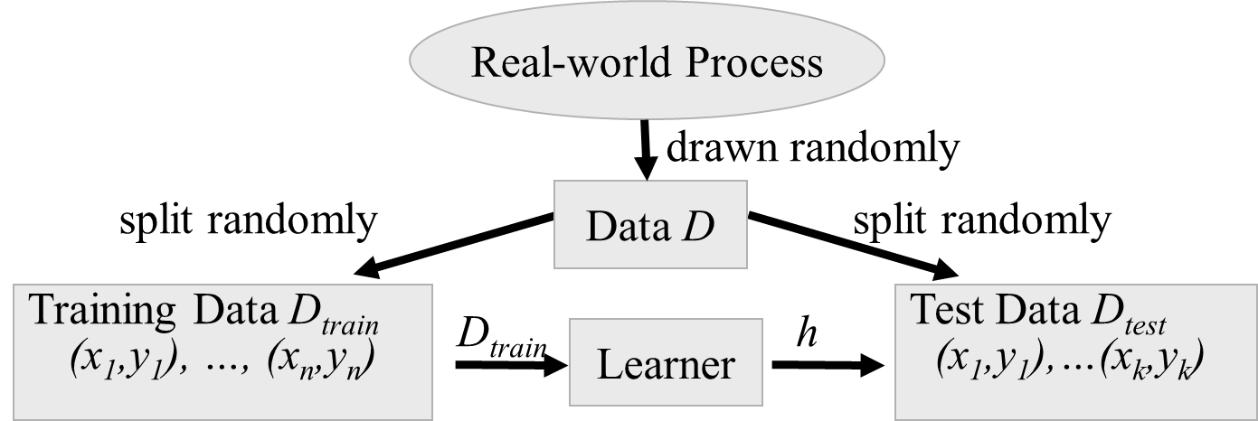
Test/Training Split
Notes:
Goal: Decouple algorithm testing from real-world process time constraints
Example: Drug effectiveness prediction (some problems with non iid for spam and stock)

Slide 8
Performance Measures
Error Rate
Fraction (or percentage) of false predictions
Accuracy
Fraction (or percentage) of correct predictions
Precision/Recall
Example: binary classification problems (classes pos/neg)
Precision: Fraction (or percentage) of correct predictions among all examples predicted to be positive
Recall: Fraction (or percentage) of correct predictions among all real positive examples
(Can be generalized to multi-class case.)

Slide 9
Learning Curve Graph
Learning curve graph
average prediction quality – proportion correct on test set –
as a function of the size of the training set..
Notes:
Peeking – example of peeking:
We generate four different hypothesis – for example by using different criteria to pick the next attribute to branch on.
We test them on the test set and we select the best hypothesis – voila’ – there was picking since the hypothesis was selcted on the basis of its performance on the test set, so information about the test set has leaked into the learning algorithm.

Slide 10
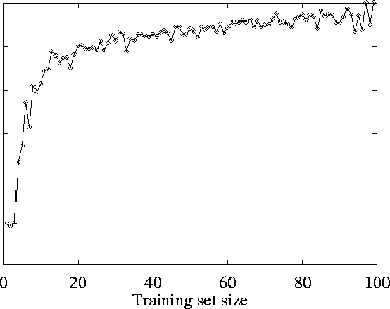
Restaurant Example: Learning Curve
On test set
As the training set increases,
so does the quality of prediction:
🡪“Happy curve” ☺!
Prediction quality:
Average Proportion correct on test set
🡪 the learning algorithm is able to capture the pattern in the data

Slide 11
Precision vs. Recall
Precision
# of true positives / (# true positives + # false positives)
Recall
# of true positives / (# true positives + # false negatives)
A precise classifier is selective
A classifier with high recall is inclusive

Slide 12
Precision-Recall curves
Measure Precision vs Recall as the classification boundary is tuned
Recall
Better learning performance
Precision

Slide 13
Precision-Recall curves
Measure Precision vs Recall as the classification boundary is tuned
Which learner is better?
Recall
Learner B
Learner A
Precision

Slide 14
Area Under Curve
AUC-PR: measure the area under the precision-recall curve
Recall
AUC=0.68
Precision

Slide 15
AUC metrics
A single number that measures “overall” performance across multiple thresholds
Useful for comparing many learners
“Smears out” PR curve
Note training / testing set dependence

Slide 16
How well does it work?
Many case studies have shown that decision trees are at least as accurate as human experts.
A study for diagnosing breast cancer had humans correctly classifying the examples 65% of the time, and the decision tree classified 72% correct.
British Petroleum designed a decision tree for gas-oil separation for offshore oil platforms that replaced an earlier rule-based expert system.
Cessna designed an airplane flight controller using 90,000 examples and 20 attributes per example.

Slide 17
Summary
Decision tree learning is a particular case of supervised learning,
For supervised learning, the aim is to find a simple hypothesis approximately consistent with training examples
Decision tree learning using information gain
Learning performance = prediction accuracy measured on test set

Slide 18
Extensions of the Decision Tree Learning Algorithm (Briefly)
Noisy data
Overfitting and Model Selection
Cross Validation
Missing Data (R&N, Section 18.3.6)
Using gain ratios (R&N, Section 18.3.6)
Real-valued data (R&N, Section 18.3.6)
Generation of rules and pruning

Slide 19
Noisy data
Many kinds of "noise" that could occur in the examples:
Two examples have same attribute/value pairs, but different classifications
🡪report majority classification for the examples corresponding to the node
deterministic hypothesis.
🡪report estimated probabilities of each classification using the relative frequency (if considering stochastic hypotheses)
Some values of attributes are incorrect because of errors in the data acquisition process or the preprocessing phase
The classification is wrong (e.g., + instead of -) because of some error
Notes:
One important reason why you don’t want to
“overfit” your learned model.

Slide 20
Overfitting
Ex.: Problem of trying to predict the roll of a die. The experiment data include:
Day of the week; (2) Month of the week; (3) Color of the die;
….
DTL may find an hypothesis that fits the data but with irrelevant attributes.
Some attributes are irrelevant to the decision-making process, e.g., color
of a die is irrelevant to its outcome but they are used to differentiate examples 🡪 Overfitting.
Overfitting means fitting the training set “too well”
🡪 performance on the test set degrades.
Example overfitting risk: Using restaurant name.

Slide 21
If the hypothesis space has many dimensions because of a large number of
attributes, we may find meaningless regularity in the data that is irrelevant
to the true, important, distinguishing features.
Fix by pruning to lower # nodes in the decision tree or put a
limit on number of nodes created.
For example, if Gain of the best attribute at a node is below a threshold, stop and make this node a leaf rather than generating children nodes.
Overfitting is a key problem in learning. There are formal results on the number of examples needed to properly train an hypothesis of a certain complexity (“number of parameters” or # nodes in DT). The more params, the more data is needed. We’ll see some of this in our discussion of PAC learning.

Slide 22
Overfitting
Let’s consider D, the entire distribution of data, and T, the training set.
Hypothesis h ∈ H overfits D if
∃ h’≠ h ∈ H such that
error_{T}(h) < error_{T}(h’) but
error_{D}(h) > error_{D}(h’)
Note: estimate error on full distribution by using test data set.

Slide 23
Data overfitting is the arguably the most common pitfall in
machine learning.
Why?
Temptation to use as much data as possible to train on. (“Ignore test till end.” Test set too small.) Data “peeking” not noticed.
Temptation to fit very complex hypothesis (e.g. large decision tree). In general, the larger the tree, the better the fit to the training data
It’s hard to think of a better fit to the training data as a “worse”
result. Often difficult to fit training data well, so it seems that
“a good fit to the training data means a good result.”
Note: Modern “savior:” Massive amounts of data to train on!
Somewhat characteristic of ML AI community vs. traditional statistics community. Anecdote: Netflix competition.

Slide 24
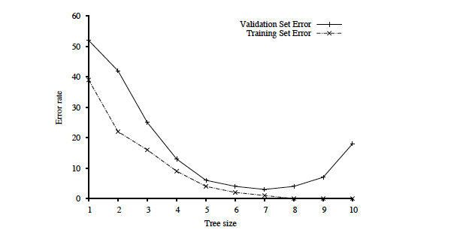
Key figure in machine learning
We set tree size as
a parameter in our
DT learning alg.
Optimal tree size
Error rate
Overfitting kicks in…
Tree size
error_{T}(h) < error_{T}(h’) but
error_{D}(h) > error_{D}(h’)
Note: with larger and larger trees,
we just do better and better on the training set!
But note the performance on the validation set…

Slide 25
Procedure for finding the optimal tree size is called “model selection.”
See section 18.4.1 R&N and Fig. 18.8.
To determine validation error for each tree size, use k-fold cross-validation. (Uses the data better than “holdout cross-validation.”)
Uses “all data - test set” --- k times splits that set into a training
set and a validation set.
After right decision tree size is found from the error rate curve on
validation data, train on all training data to get final decision tree
(of the right size).
Finally, evaluate tree on the test data (not used before) to get
true generalization error (to unseen examples).

Slide 26
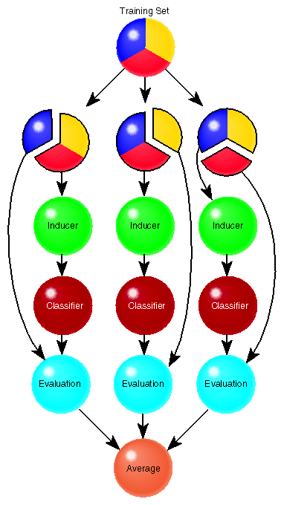
Cross Validation
Learner L is e.g. DT learner for “tree with
7 nodes” max.
A method for estimating the accuracy
(or error) of a learner (using validation set).
CV( data S, alg L, int k )
Divide S into k disjoint sets { S₁, S₂, …, S_{k} }
For i = 1..k do
Run L on S_{-i} = S – S_{i}
obtain L(S_{-i}) = h_{i}
Evaluate h_{i} on S_{i}
err_{Si}(h_{i}) = 1/|S_{i}| ∑ _{〈 x,y〉 ∈ Si} I(h_{i}(x) ≠ y)
Return Average 1/k ∑_{i} err_{Si}(h_{i})

Slide 27
Specific techniques for dealing with overfitting (Model selection provides general framework)
1) Decision tree pruning or grow only up to certain size.
Prevent splitting on features that are not clearly relevant.
Testing of relevance of features --- “does split provide new information”:
statistical tests ---> Section 18.3.5 R&N test.
2) Grow full tree, then post-prune rule post-pruning
3)
MDL (minimal description length):
minimize
size(tree) + size(misclassifications(tree))

Slide 28
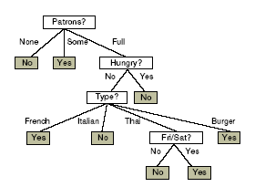
Converting Trees to Rules
Every decision tree corresponds to set of rules:
IF (Patrons = None)
THEN WillWait = No
IF (Patrons = Full) & (Hungry = No) &(Type = French)
THEN WillWait = Yes
...

Slide 29
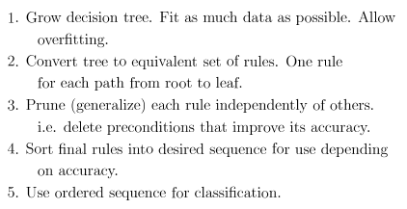
Fighting Overfitting: Using Rule Post-Pruning

Slide 30
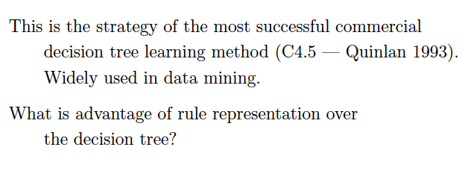

Slide 31
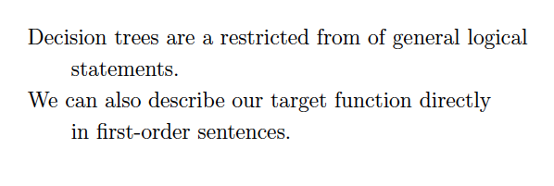
Logical aside

Slide 32
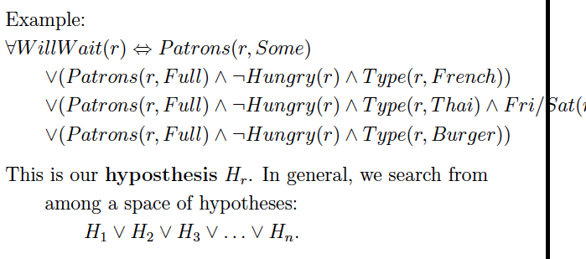

Slide 33
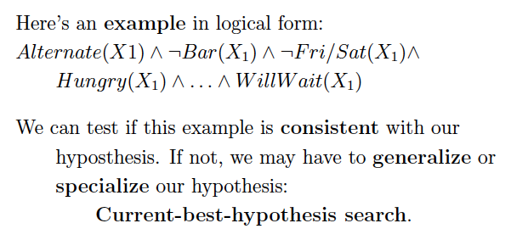
End logical aside

Slide 34
Summary: When to use Decision Trees
Instances presented as attribute-value pairs
Method of approximating discrete-valued functions
Target function has discrete values: classification problems
Robust to noisy data:
Training data may contain
errors
missing attribute values
Typical bias: prefer smaller trees (Ockham's razor )
Widely used, practical and easy to interpret results

Slide 35
Inducing decision trees is one of the most widely used learning methods in practice
Can outperform human experts in many problems
Strengths include
Fast
simple to implement
human readable
can convert result to a set of easily interpretable rules
empirically valid in many commercial products
handles noisy data
Weaknesses include:
"Univariate" splits/partitioning using only one attribute at a time so limits types of possible trees
large decision trees may be hard to understand
requires fixed-length feature vectors
non-incremental (i.e., batch method)
Can be a legal requirement! Why?

Slide 36
DECISION TREES IN SCIKIT
from sklearn.datasets import load_iris
from sklearn import tree
# Load a common dataset, fit a decision tree to it
iris = load_iris()
clf = tree.DecisionTreeClassifier()
clf = clf.fit(iris.data, iris.target)
Trains a decision tree using default parameters (attribute chosen to split on either Gini or entropy, no max depth, etc)
# Predict most likely class
clf.predict([[2., 2.]])
# Predict PDF over classes (%training samples in leaf)
clf.predict_proba([[2., 2.]])

Slide 37
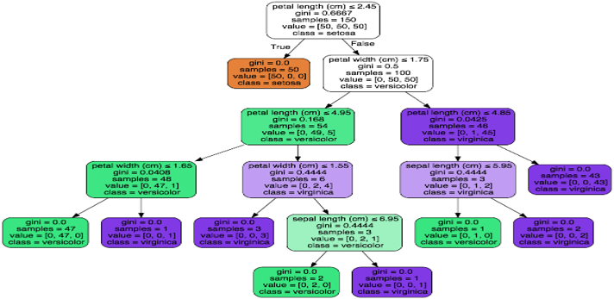
VISUALIZING A DECISION TREE
from IPython.display import Image
dot_data = tree.export_graphviz(clf,
out_file=None,
feature_names=iris.feature_names,
class_names=iris.target_names,
filled=True, rounded=True)
graph = pydotplus.graph_from_dot_data(dot_data)
Image(graph.create_png())

Slide 38

RANDOM FORESTS
Decision trees are very interpretable, but may be brittle to changes in the training data, as well as noise
Random forests are an ensemble method that:
Resamples the training data;
Builds many decision trees; and
Averages predictions of trees to classify.
This is done through bagging and random feature selection

Slide 39
BAGGING
Bagging: Bootstrap aggregation
Resampling a training set of size n via the bootstrap:
Sample with replacement n elements
General scheme for random forests:
Create B bootstrap samples, {Z₁, Z₂, …, Z_{B}}
Build B decision trees, {T₁, T₂, …, T_{B}}, from {Z₁, Z₂, …, Z_{B}}
Classification/Regression:
Each tree T_{j} predicts class/value y_{j}
Return average 1/B Σ_{j={1,...,B}} y_{j} for regression, or majority vote for classification

Slide 40
obs_id | ft_1 | ft_2
1 | 12.2 | puppy
2 | 34.5 | dog
3 | 8.1 | cat
Original training dataset (Z):
B Bootstrap samples Z_{j}
Z₁
Z₂
Z_{B}
obs_id | ft_1 | ft_2
3 | 8.1 | cat
2 | 34.5 | dog
3 | 8.1 | cat
obs_id | ft_1 | ft_2
1 | 12.2 | puppy
2 | 34.5 | dog
1 | 12.2 | puppy
obs_id | ft_1 | ft_2
1 | 12.2 | puppy
1 | 12.2 | puppy
3 | 8.1 | cat
T₁
T₂
T_{j}
T_{B}
Aggregate/Vote
Class estimate or predicted value

Slide 41
RANDOM ATTRIBUTE SELECTION
We get some randomness via bootstrapping
We like this! Randomness increases the bias of the forest slightly at a huge decrease in variance (due to averaging)
We can further reduce correlation between trees by:
For each tree, at every split point …
… choose a random subset of attributes …
… then split on the “best” (entropy, Gini) within only that subset

Slide 42

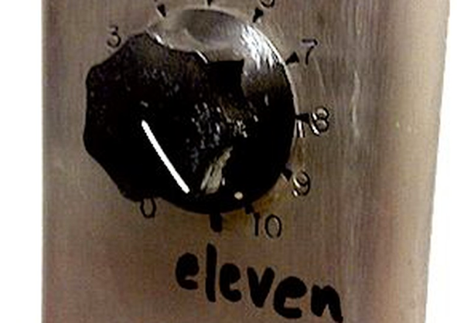
RANDOM FORESTS IN SCIKIT-LEARN
from sklearn.ensemble import RandomForestClassifier
# Train a random forest of 10 default decision trees
X = [[0, 0], [1, 1]]
Y = [0, 1]
clf = RandomForestClassifier(n_estimators=10)
clf = clf.fit(X, Y)
Can we get even more random?!
Extremely randomized trees (ExtraTreesClassifier) do bagging, random attribute selection, but also:
At each split point, choose random splits
Pick the best of those random splits
Similar bias/variance performance to RFs, but can be faster computationally

Slide 43
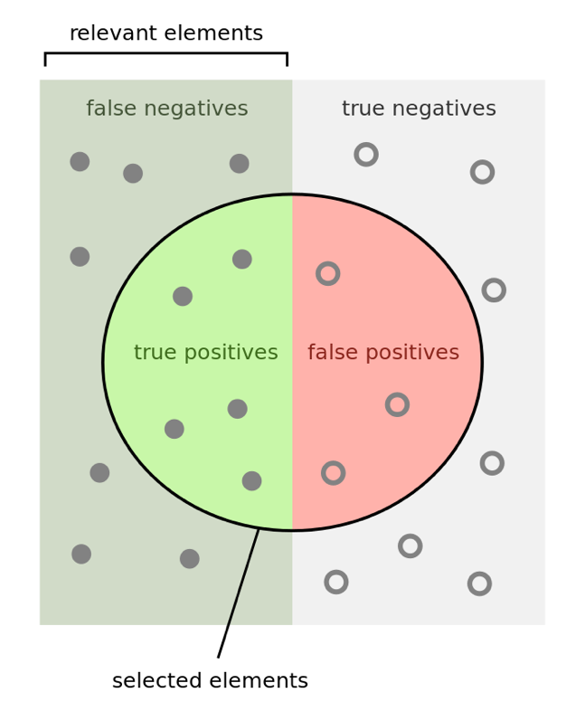
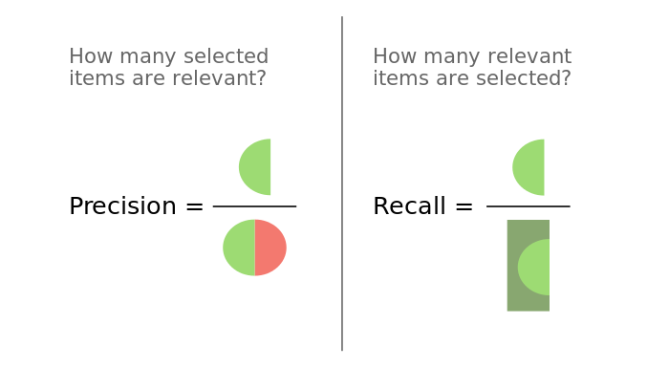
QUICK ASIDE FOR PROJECT #3
Precision P: #correct positive results / #positive results returned
Recall R: #correct positive results / #all possible positive results

Slide 44
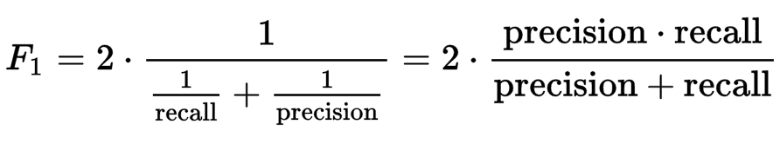
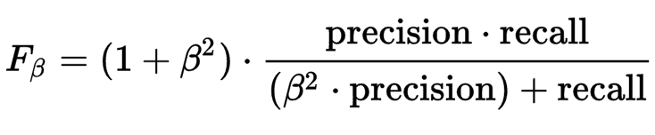
QUICK ASIDE FOR PROJECT #3
F-Score F: weighted average of the precision and recall of a test
F₁: (harmonic) mean of precision and recall:
Can be parameterized to attach higher importance to recall:
Notes:
Harmonic mean = good for rates vs absolute numbers

Slide 45
TODAY’S LECTURE
Data collection
Data processing
Exploratory analysis
&
Data viz
Analysis, hypothesis testing, & ML
Insight & Policy Decision

Slide 46
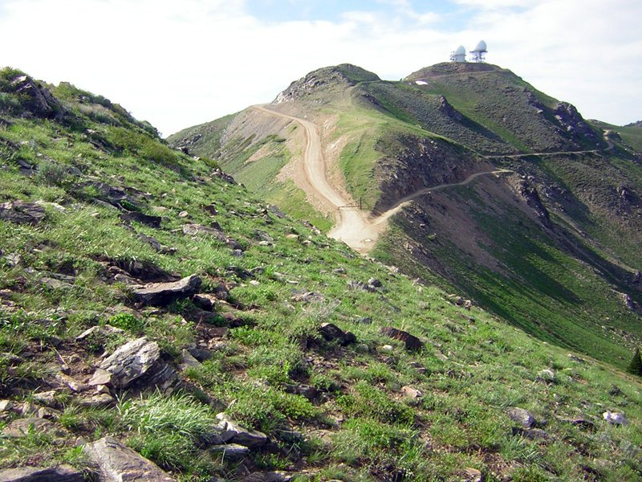
FILLING IN THE GAPS: NONLINEAR REGRESSION & REGULARIZATION
Thanks: Zico Kolter

Slide 47
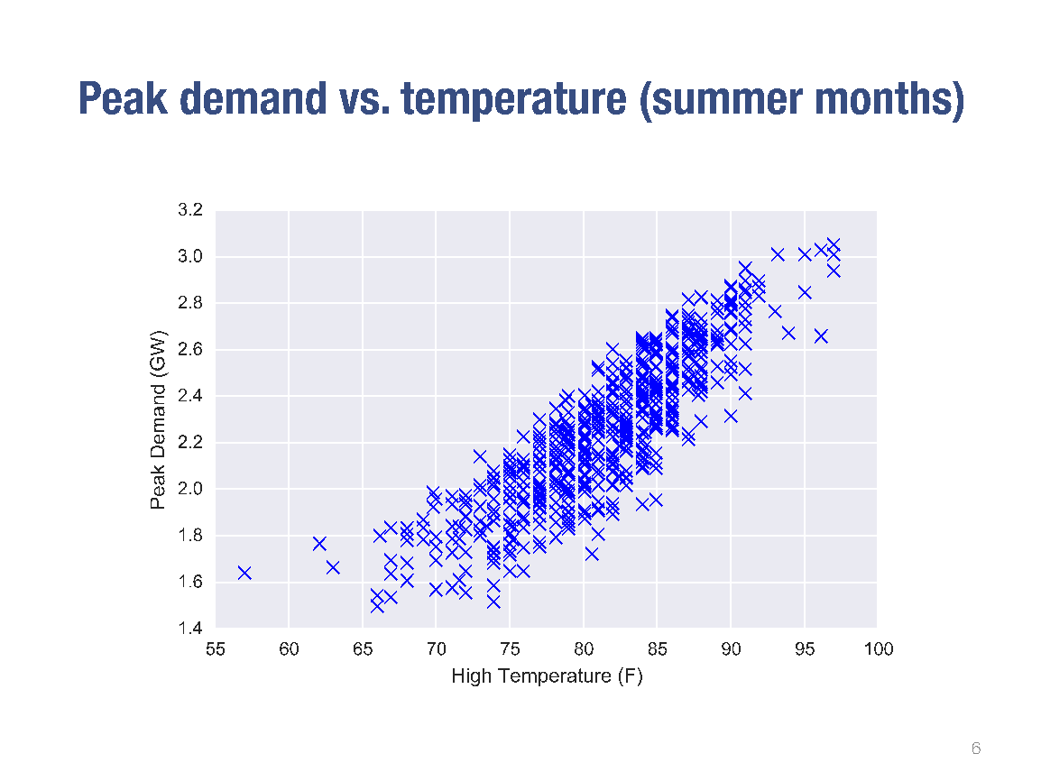

Slide 48
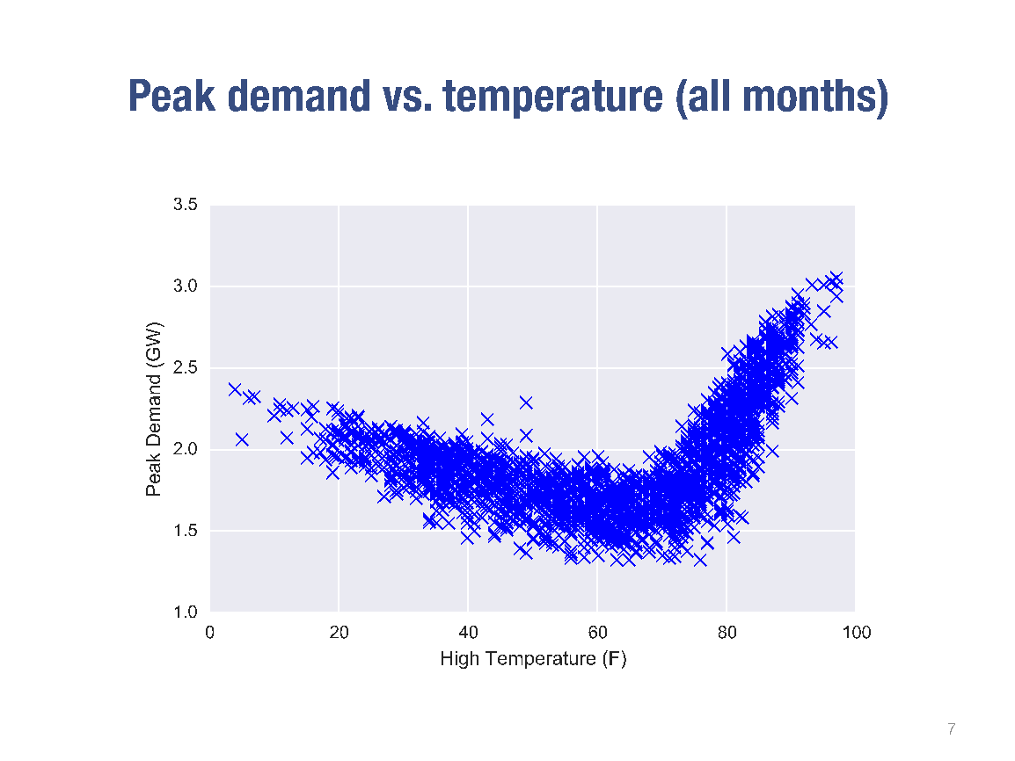

Slide 49
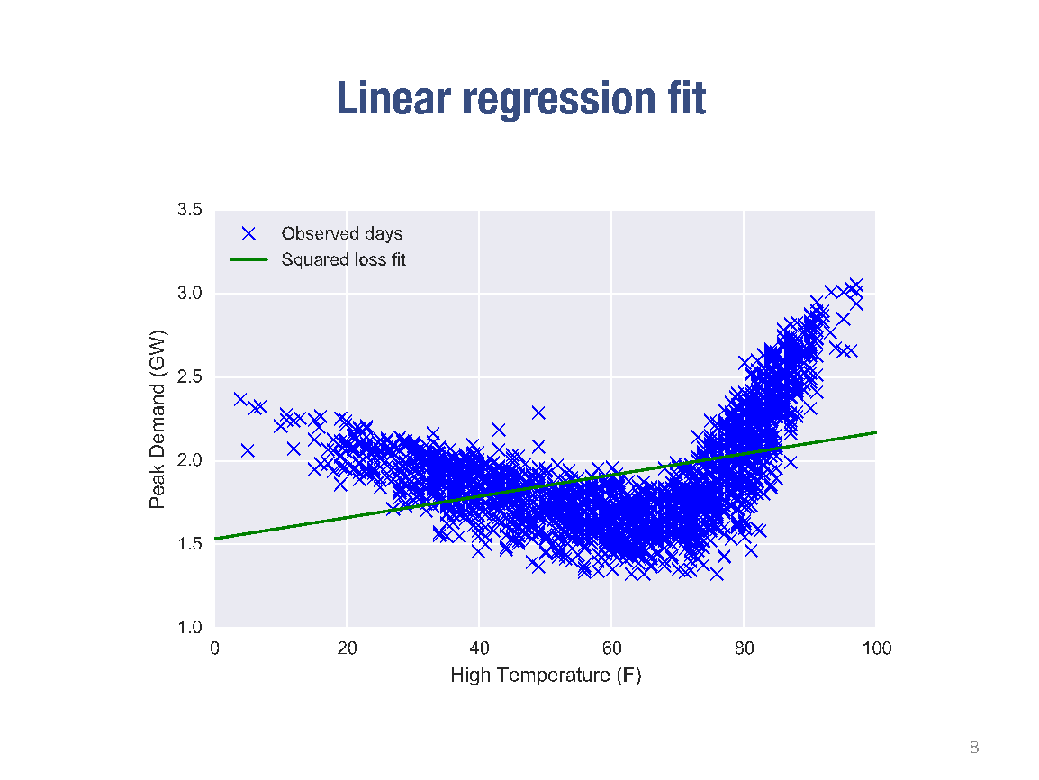

Slide 50
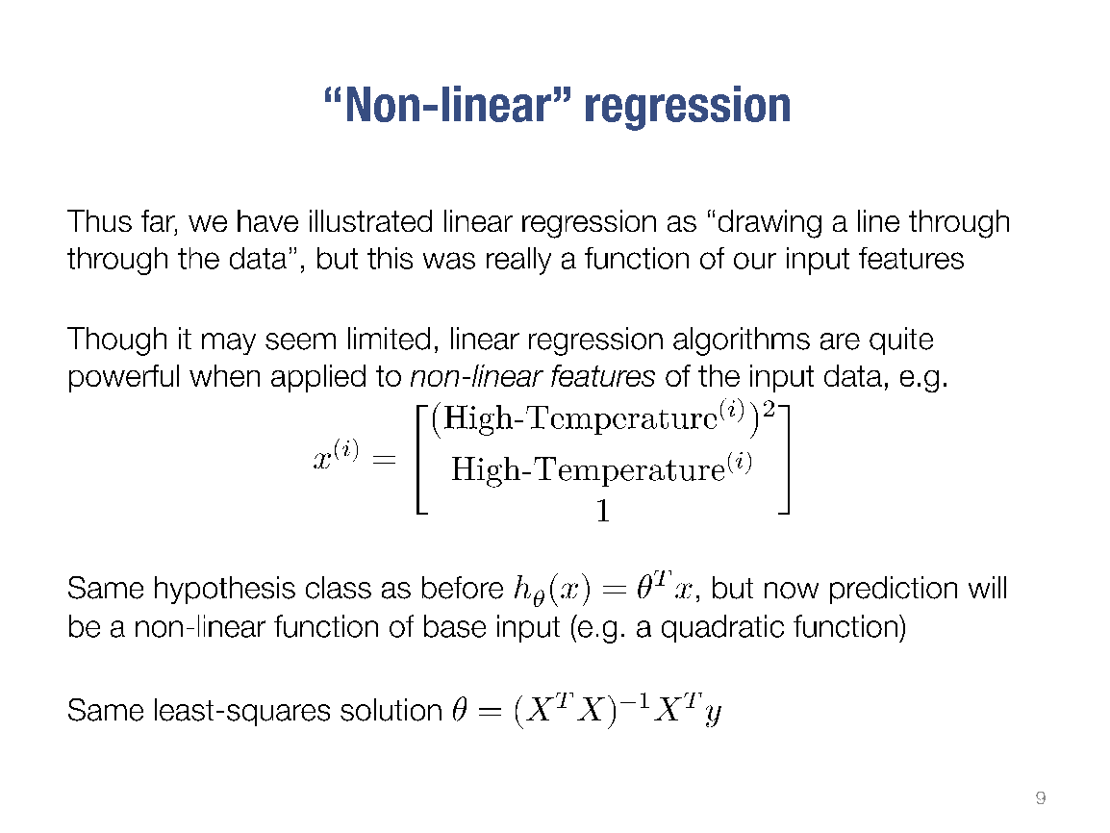

Slide 51
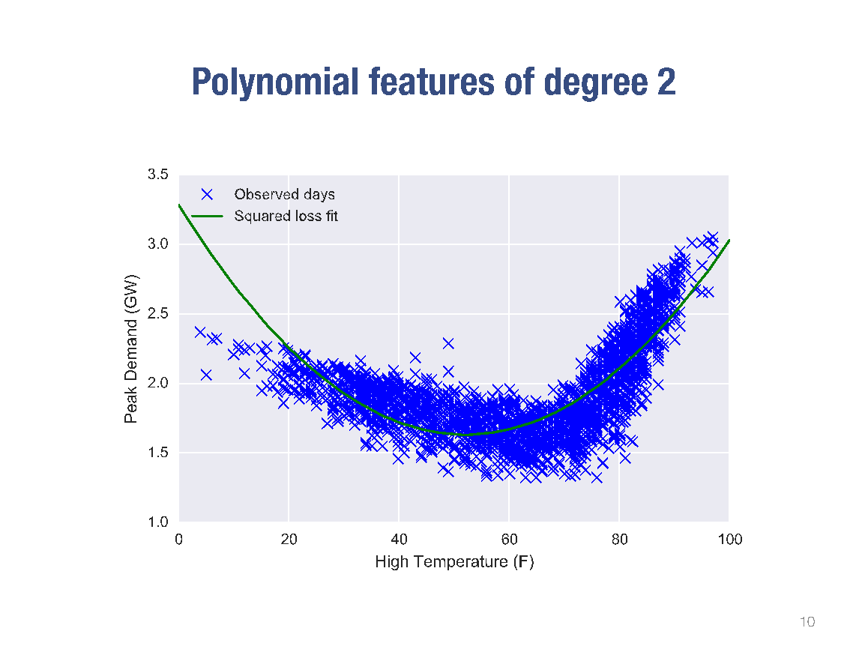

Slide 52
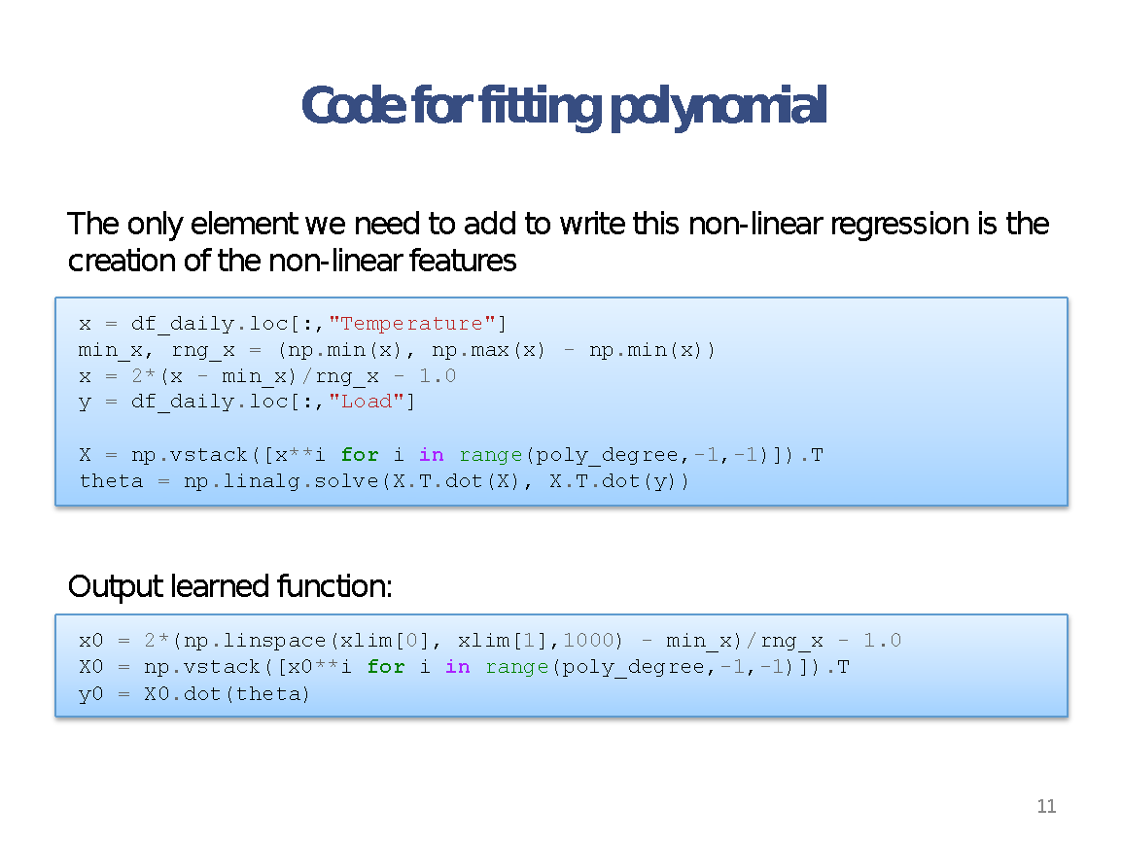

Slide 53


Slide 54


Slide 55


Slide 56


Slide 57
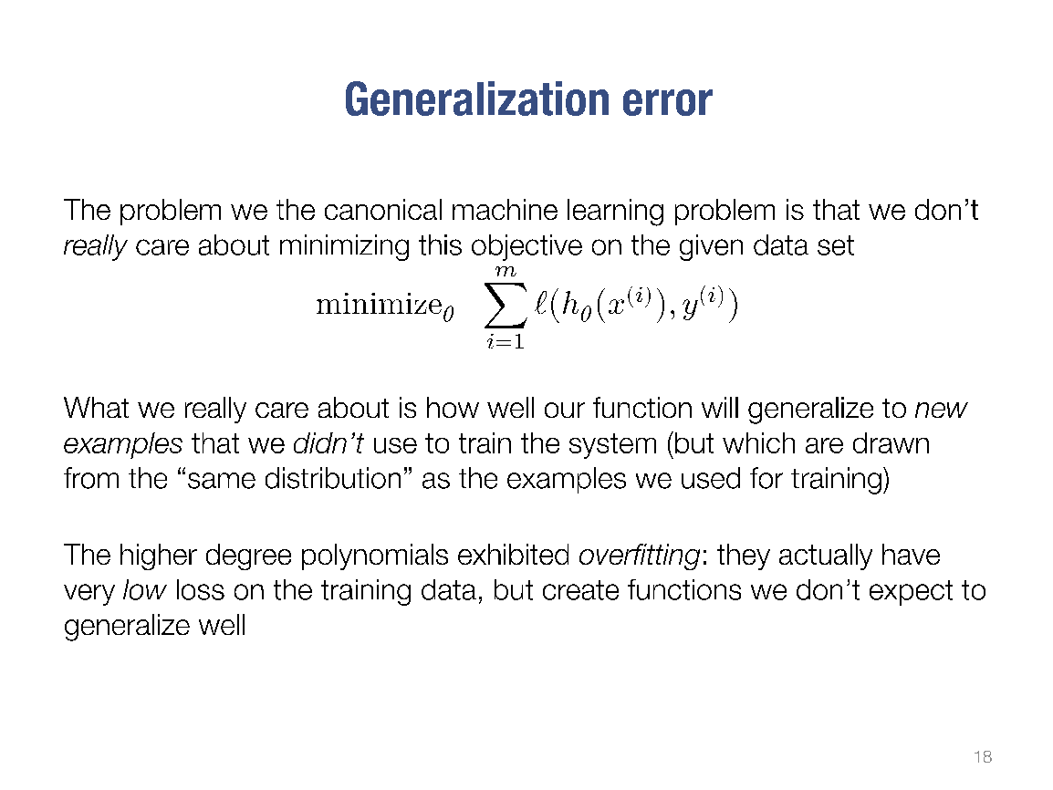

Slide 58
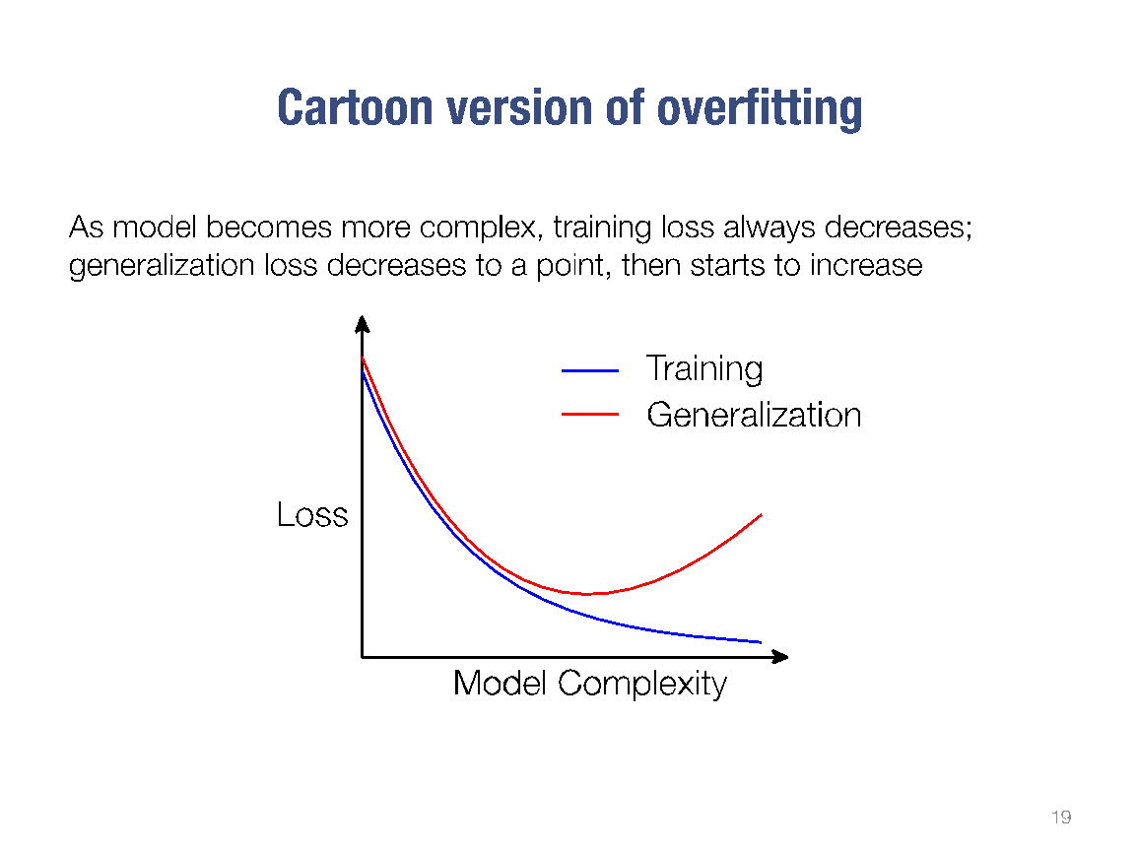

Slide 59
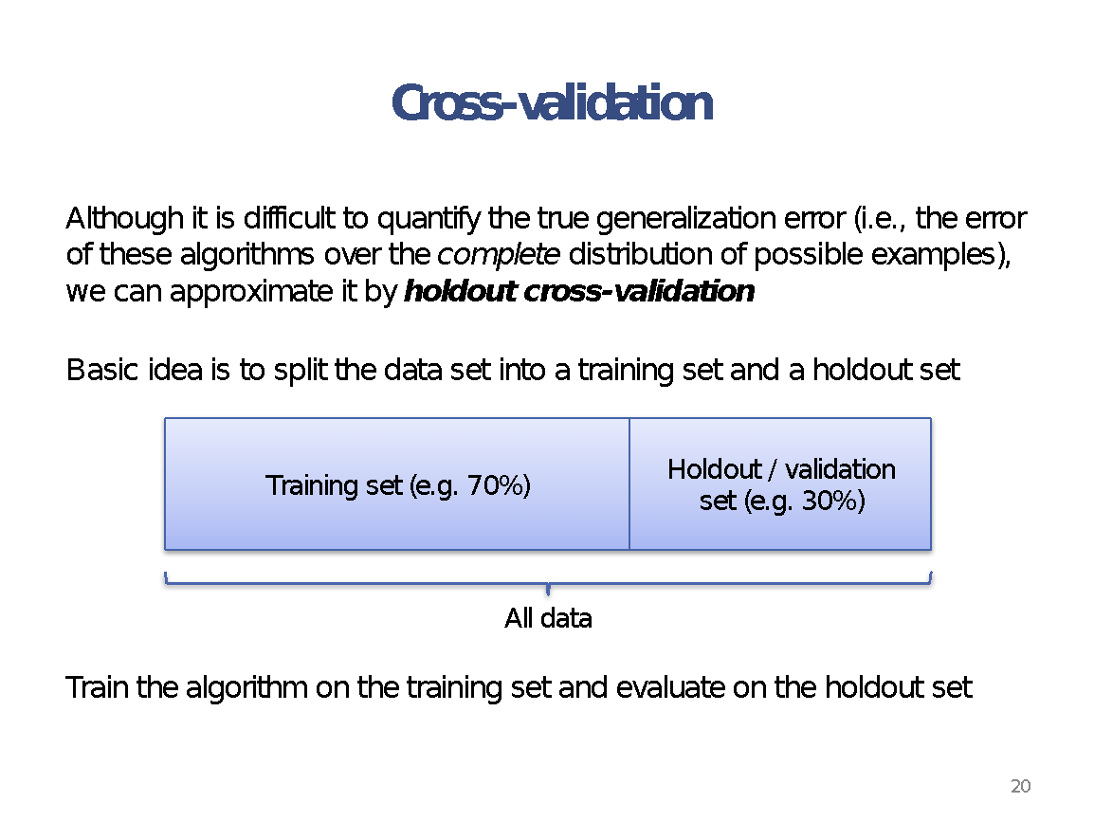

Slide 60


Slide 61
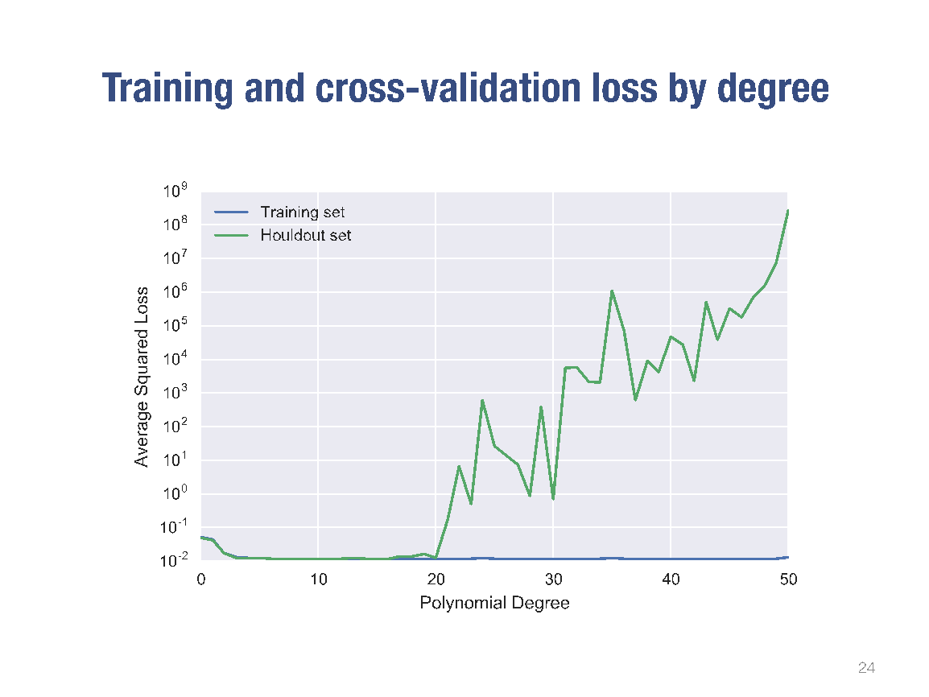

Slide 62
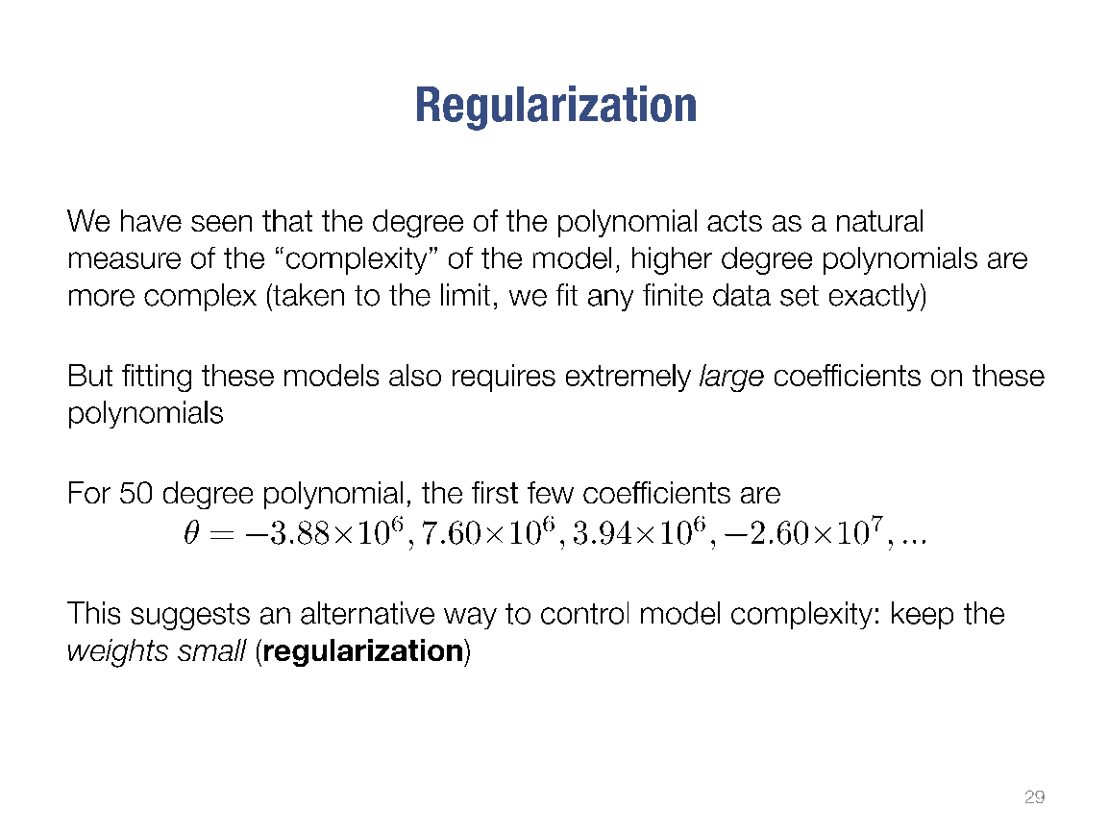

Slide 63
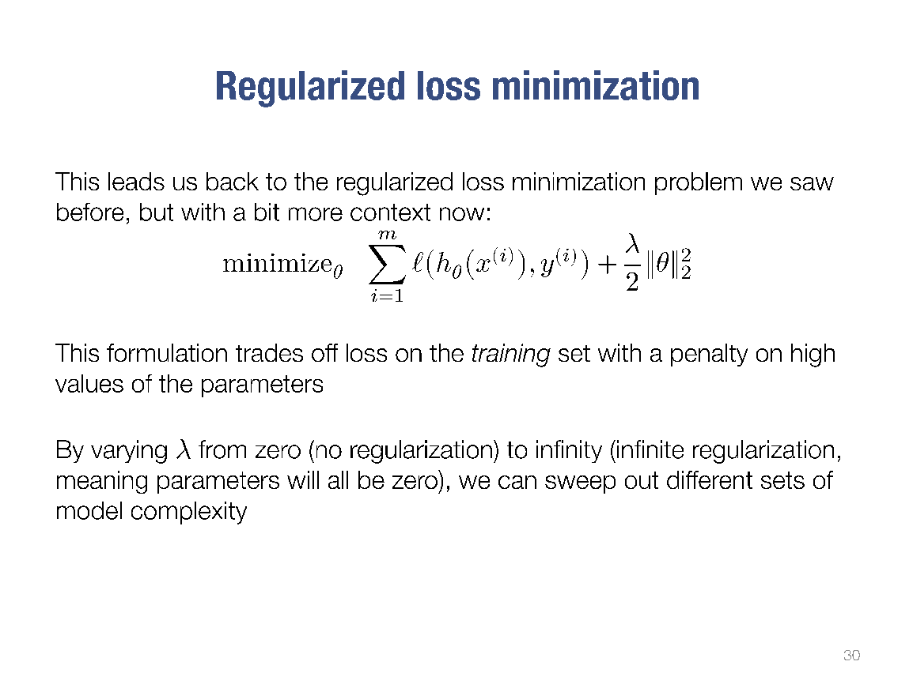

Slide 64
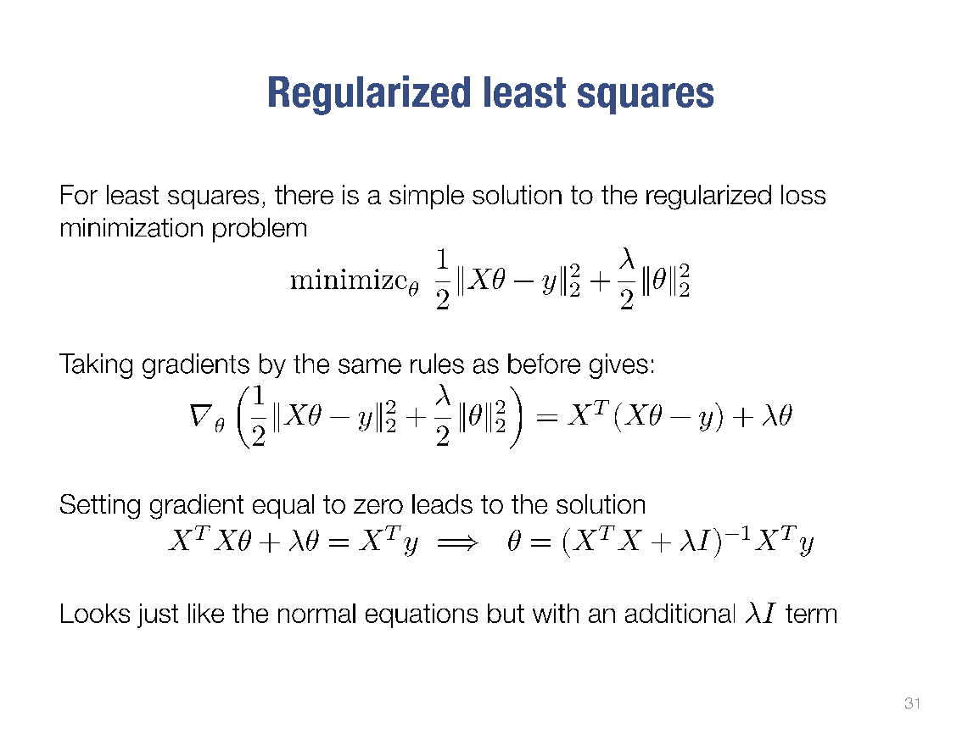

Slide 65
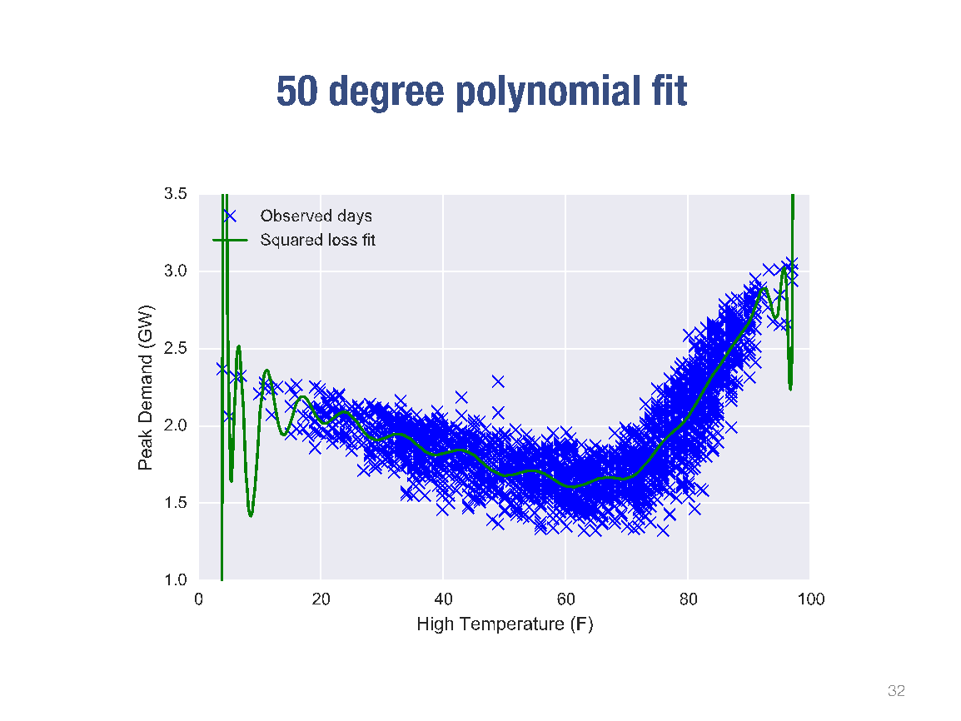

Slide 66


Slide 67
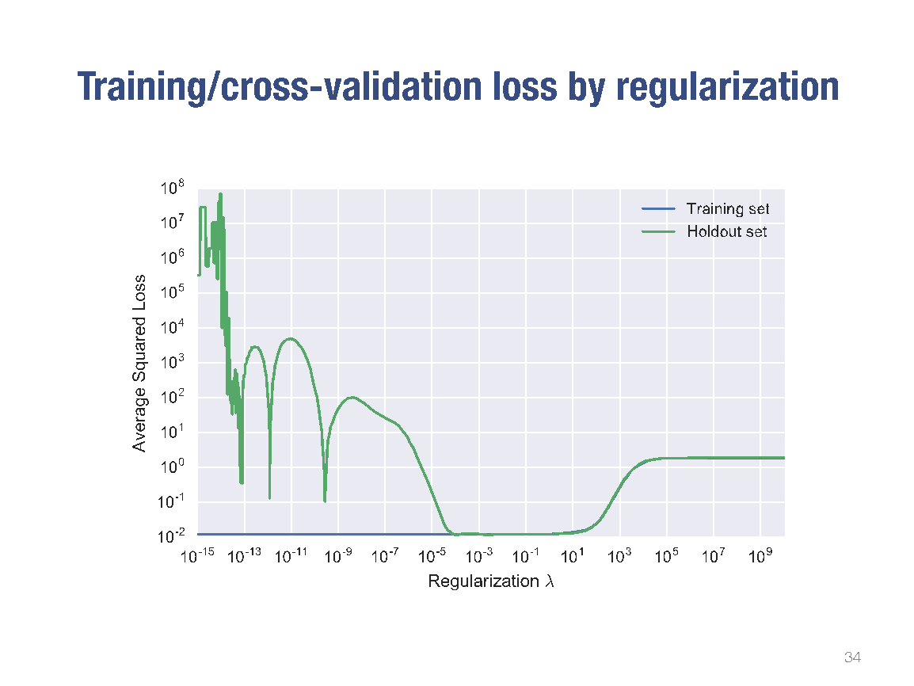

Slide 68
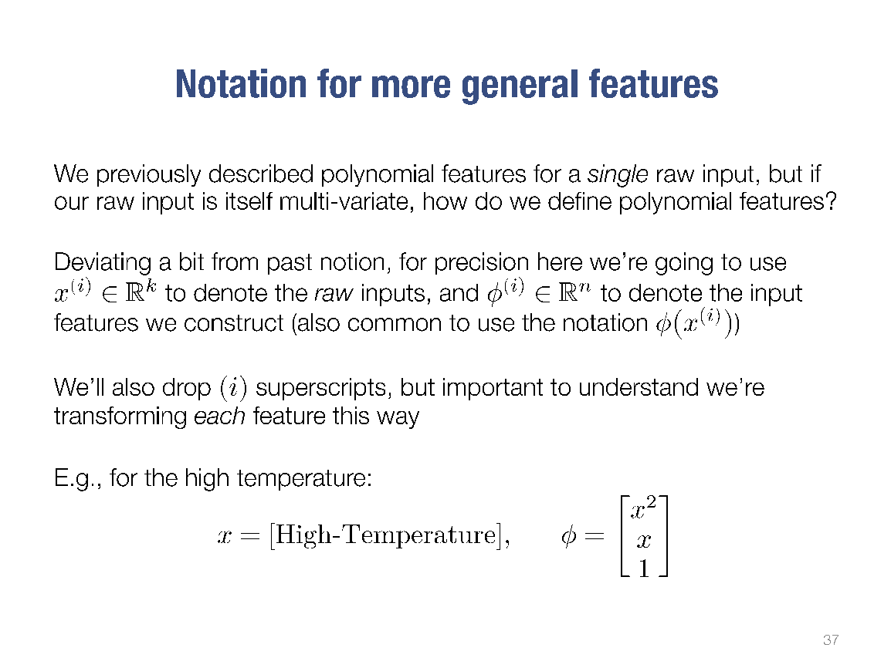

Slide 69
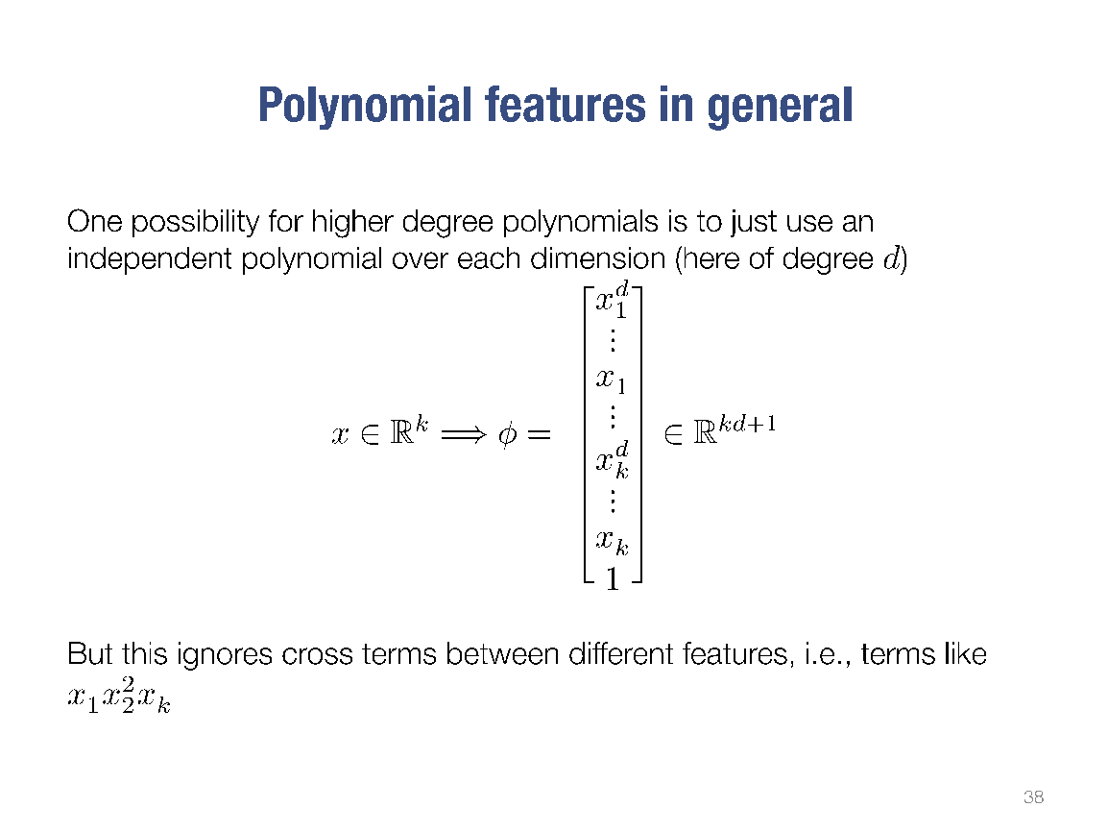

Slide 70
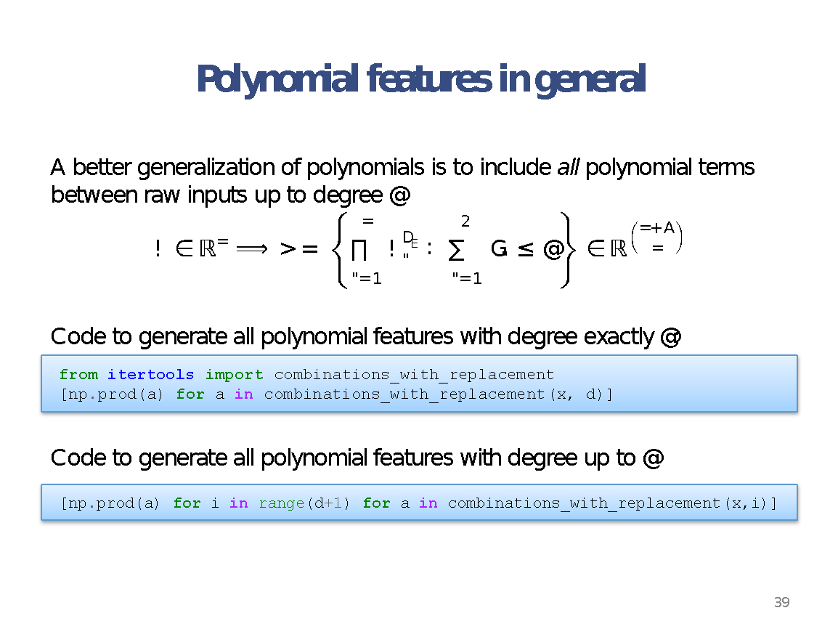
combinations_with_replacement(p,r):
r-length tuples, in sorted order, with replacement

Slide 71
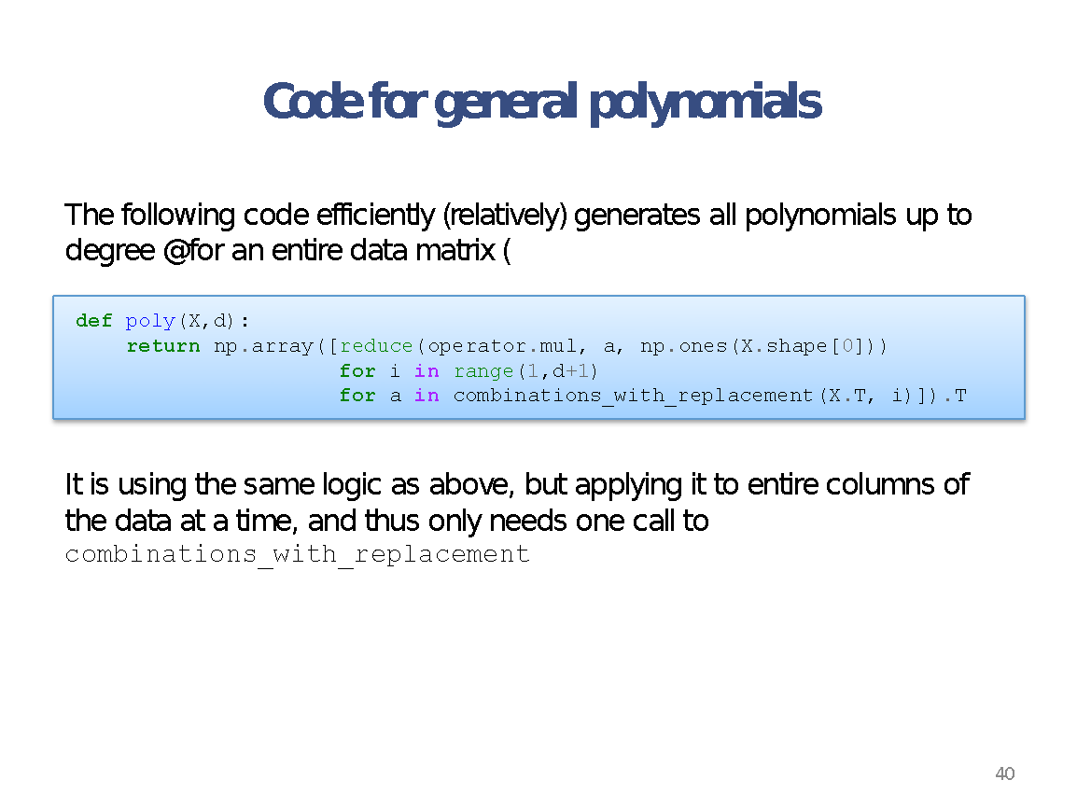

Slide 72
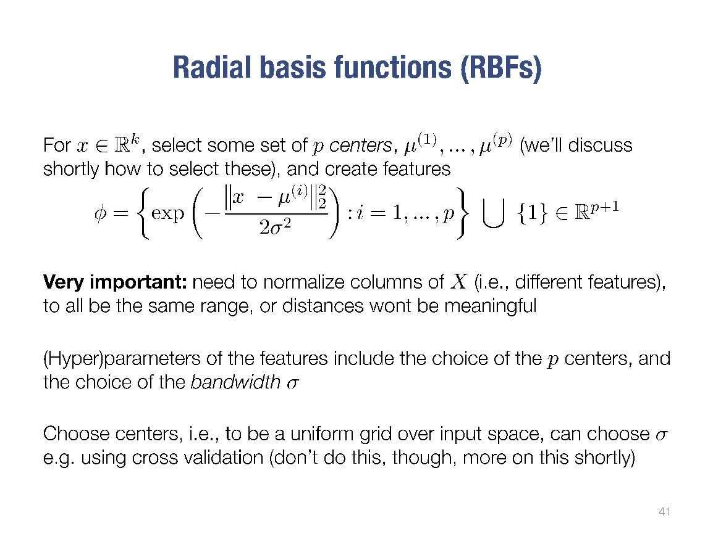

Slide 73
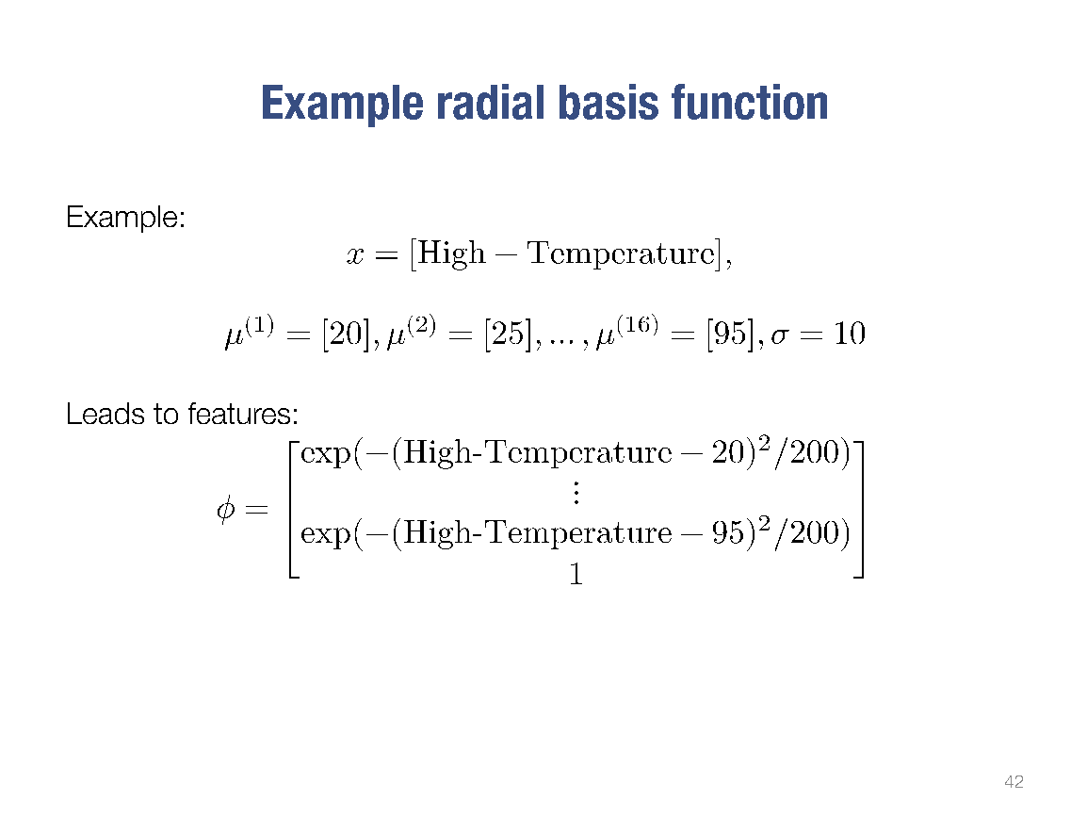

Slide 74
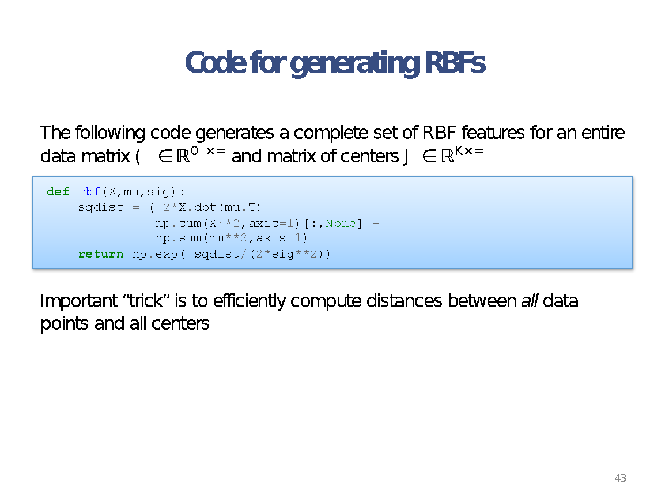

Slide 75
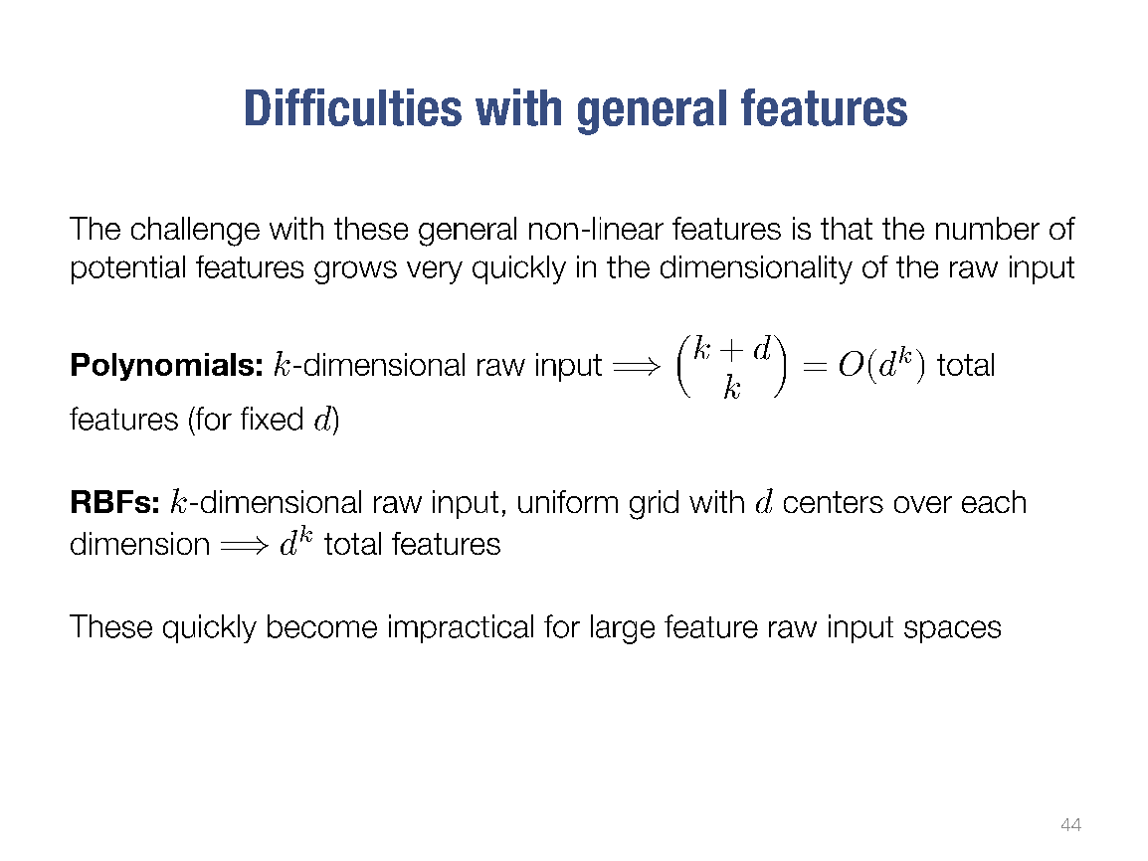

Slide 76
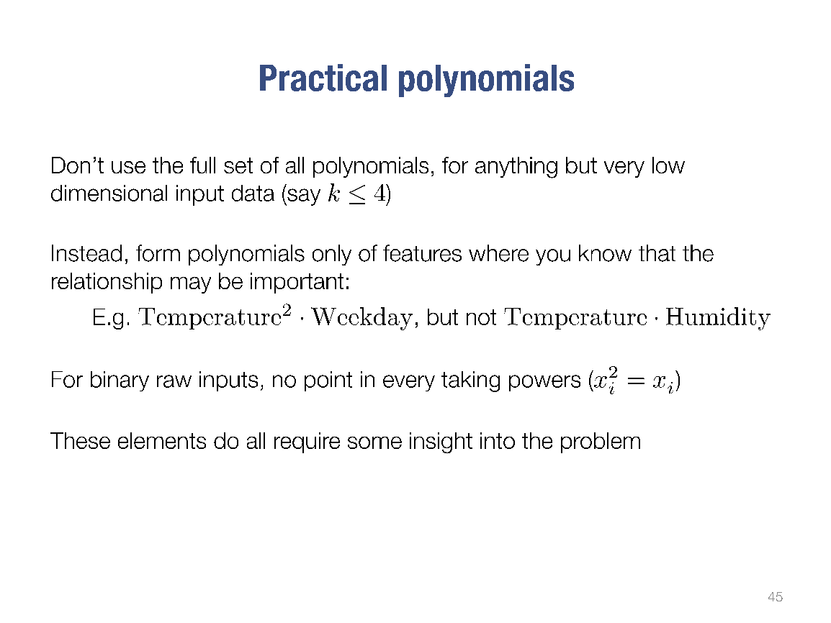

Slide 77
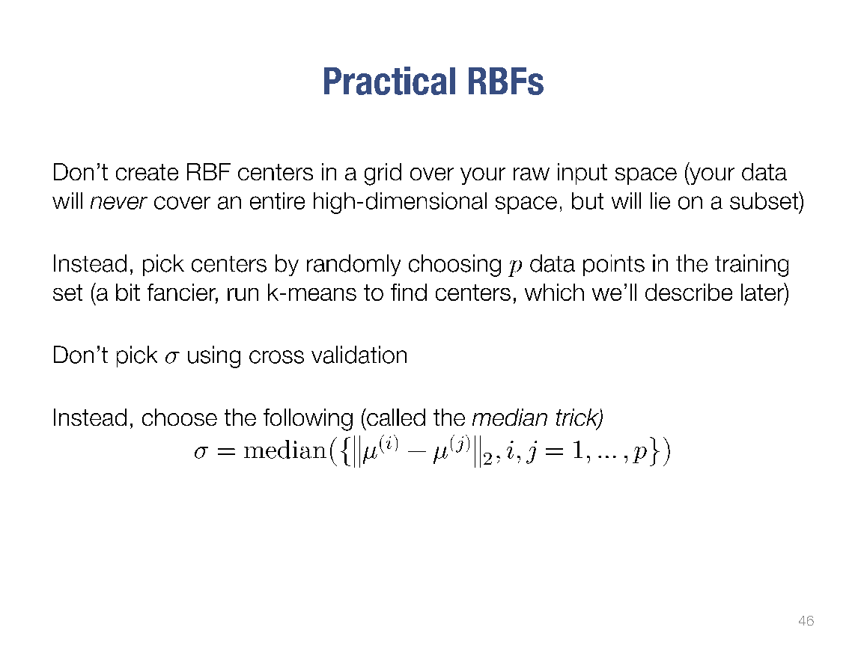

Slide 78
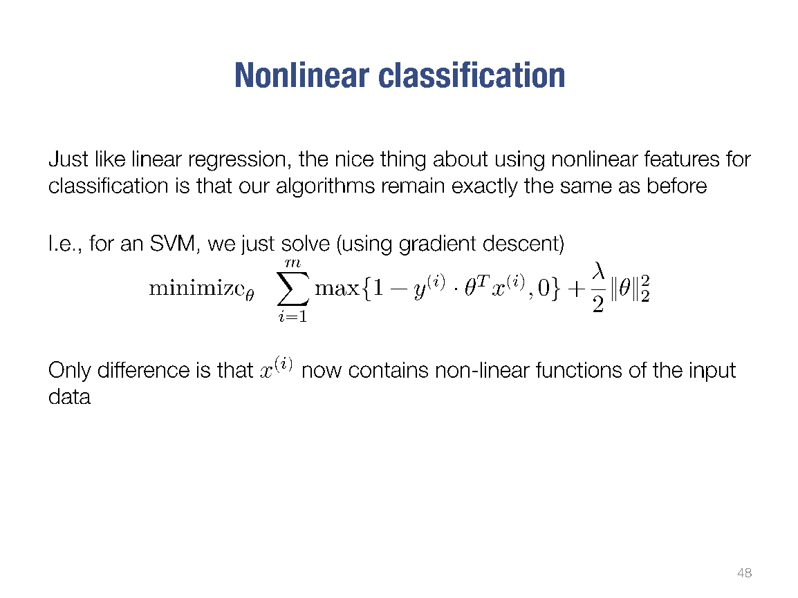

Slide 79
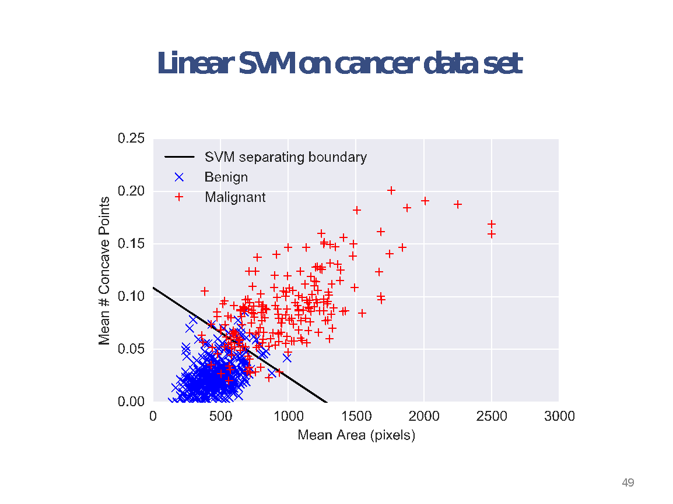

Slide 80


Slide 81


Slide 82


